Slide 1
Artificial intelligence
Session – 12
Date – 14th June, 2022

Slide 2
Need for Machine Learning
The need for machine learning is increasing day by day. The reason behind the need for machine learning is that it is capable of doing tasks that are too complex for a person to implement directly. As a human, we have some limitations as we cannot access the huge amount of data manually, so for this, we need some computer systems and here comes the machine learning to make things easy for us.
We can train machine learning algorithms by providing them the huge amount of data and let them explore the data, construct the models, and predict the required output automatically. The performance of the machine learning algorithm depends on the amount of data, and it can be determined by the cost function. With the help of machine learning, we can save both time and money.
The importance of machine learning can be easily understood by its uses cases, Currently, machine learning is used in self-driving cars, cyber fraud detection, face recognition, and friend suggestion by Facebook, etc. Various top companies such as Netflix and Amazon have build machine learning models that are using a vast amount of data to analyze the user interest and recommend product accordingly.
Following are some key points which show the importance of Machine Learning:
Rapid increment in the production of data
Solving complex problems, which are difficult for a human
Decision making in various sector including finance
Finding hidden patterns and extracting useful information from data.

Slide 3
Reinforcement Learning
Reinforcement learning is a feedback-based learning method, in which a learning agent gets a reward for each right action and gets a penalty for each wrong action. The agent learns automatically with these feedbacks and improves its performance. In reinforcement learning, the agent interacts with the environment and explores it. The goal of an agent is to get the most reward points, and hence, it improves its performance.
The robotic dog, which automatically learns the movement of his arms, is an example of Reinforcement learning.

Slide 4
Supervised Machine Learning
Supervised learning is the types of machine learning in which machines are trained using well "labelled" training data, and on basis of that data, machines predict the output. The labelled data means some input data is already tagged with the correct output.
In supervised learning, the training data provided to the machines work as the supervisor that teaches the machines to predict the output correctly. It applies the same concept as a student learns in the supervision of the teacher.
Supervised learning is a process of providing input data as well as correct output data to the machine learning model. The aim of a supervised learning algorithm is to find a mapping function to map the input variable(x) with the output variable(y).
In the real-world, supervised learning can be used for Risk Assessment, Image classification, Fraud Detection, spam filtering, etc.

Slide 5
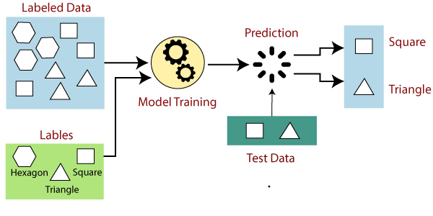
How Supervised Learning Works?
In supervised learning, models are trained using labelled dataset, where the model learns about each type of data. Once the training process is completed, the model is tested on the basis of test data (a subset of the training set), and then it predicts the output.
The working of Supervised learning can be easily understood by the below example and diagram:
Suppose we have a dataset of different types of shapes which includes square, rectangle, triangle, and Polygon. Now the first step is that we need to train the model for each shape.
If the given shape has four sides, and all the sides are equal, then it will be labelled as a Square.
If the given shape has three sides, then it will be labelled as a triangle.
If the given shape has six equal sides then it will be labelled as hexagon.
Now, after training, we test our model using the test set, and the task of the model is to identify the shape.
The machine is already trained on all types of shapes, and when it finds a new shape, it classifies the shape on the bases of a number of sides, and predicts the output.

Slide 6
Steps Involved in Supervised Learning:
First Determine the type of training dataset
Collect/Gather the labelled training data.
Split the training dataset into training dataset, test dataset, and validation dataset.
Determine the input features of the training dataset, which should have enough knowledge so that the model can accurately predict the output.
Determine the suitable algorithm for the model, such as support vector machine, decision tree, etc.
Execute the algorithm on the training dataset. Sometimes we need validation sets as the control parameters, which are the subset of training datasets.
Evaluate the accuracy of the model by providing the test set. If the model predicts the correct output, which means our model is accurate.

Slide 7
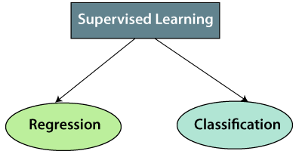
Types of supervised Machine learning Algorithms:
Supervised learning can be further divided into two types of problems:
1. Regression
Regression algorithms are used if there is a relationship between the input variable and the output variable. It is used for the prediction of continuous variables, such as Weather forecasting, Market Trends, etc. Below are some popular Regression algorithms which come under supervised learning:
Linear Regression
Regression Trees
Non-Linear Regression
Bayesian Linear Regression
Polynomial Regression
2. Classification
Classification algorithms are used when the output variable is categorical, which means there are two classes such as Yes-No, Male-Female, True-false, etc.
Spam Filtering,
Random Forest
Decision Trees
Logistic Regression
Support vector Machines

Slide 8
Advantages of Supervised learning:
Disadvantages of supervised learning:
With the help of supervised learning, the model can predict the output on the basis of prior experiences.
In supervised learning, we can have an exact idea about the classes of objects.
Supervised learning model helps us to solve various real-world problems such as fraud detection, spam filtering, etc.
Supervised learning models are not suitable for handling the complex tasks.
Supervised learning cannot predict the correct output if the test data is different from the training dataset.
Training required lots of computation times.
In supervised learning, we need enough knowledge about the classes of object.

Slide 9
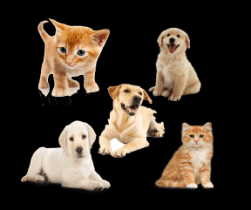
Unsupervised Machine Learning
In the previous topic, we learned supervised machine learning in which models are trained using labeled data under the supervision of training data. But there may be many cases in which we do not have labeled data and need to find the hidden patterns from the given dataset. So, to solve such types of cases in machine learning, we need unsupervised learning techniques.
What is Unsupervised Learning?
As the name suggests, unsupervised learning is a machine learning technique in which models are not supervised using training dataset. Instead, models itself find the hidden patterns and insights from the given data. It can be compared to learning which takes place in the human brain while learning new things. It can be defined as:
Unsupervised learning is a type of machine learning in which models are trained using unlabeled dataset and are allowed to act on that data without any supervision.
Unsupervised learning cannot be directly applied to a regression or classification problem because unlike supervised learning, we have the input data but no corresponding output data. The goal of unsupervised learning is to find the underlying structure of dataset, group that data according to similarities, and represent that dataset in a compressed format.
Example: Suppose the unsupervised learning algorithm is given an input dataset containing images of different types of cats and dogs. The algorithm is never trained upon the given dataset, which means it does not have any idea about the features of the dataset. The task of the unsupervised learning algorithm is to identify the image features on their own. Unsupervised learning algorithm will perform this task by clustering the image dataset into the groups according to similarities between images.

Slide 10
Why use Unsupervised Learning?
Below are some main reasons which describe the importance of Unsupervised Learning:
Unsupervised learning is helpful for finding useful insights from the data.
Unsupervised learning is much similar as a human learns to think by their own experiences, which makes it closer to the real AI.
Unsupervised learning works on unlabeled and uncategorized data which make unsupervised learning more important.
In real-world, we do not always have input data with the corresponding output so to solve such cases, we need unsupervised learning.
Example:
10000 images of person wearing masks.
10000 images of person not wearing masks.
It will categorize the data in 1 and 0 format based on person wearing a mask or not

Slide 11
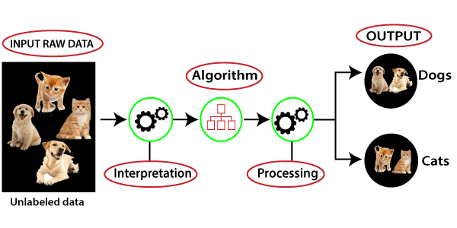
Working of Unsupervised Learning
Working of unsupervised learning can be understood by the below diagram:
Here, we have taken an unlabeled input data, which means it is not categorized and corresponding outputs are also not given. Now, this unlabeled input data is fed to the machine learning model in order to train it. Firstly, it will interpret the raw data to find the hidden patterns from the data and then will apply suitable algorithms such as k-means clustering, Decision tree, etc.
Once it applies the suitable algorithm, the algorithm divides the data objects into groups according to the similarities and difference between the objects.

Slide 12
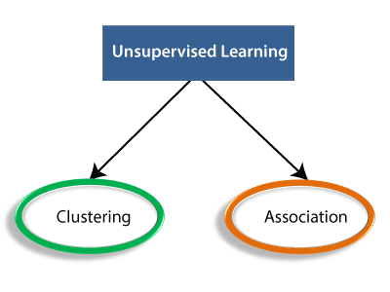
Types of Unsupervised Learning Algorithm:
The unsupervised learning algorithm can be further categorized into two types of problems:
Clustering: Clustering is a method of grouping the objects into clusters such that objects with most similarities remains into a group and has less or no similarities with the objects of another group. Cluster analysis finds the commonalities between the data objects and categorizes them as per the presence and absence of those commonalities.
Association: An association rule is an unsupervised learning method which is used for finding the relationships between variables in the large database. It determines the set of items that occurs together in the dataset. Association rule makes marketing strategy more effective. Such as people who buy X item (suppose a bread) are also tend to purchase Y (Butter/Jam) item. A typical example of Association rule is Market Basket Analysis.

Slide 13
Unsupervised Learning algorithms:
Below is the list of some popular unsupervised learning algorithms:
K-means clustering
KNN (k-nearest neighbors)
Hierarchal clustering
Anomaly detection
Neural Networks
Principle Component Analysis
Independent Component Analysis
Apriori algorithm
Singular value decomposition

Slide 14
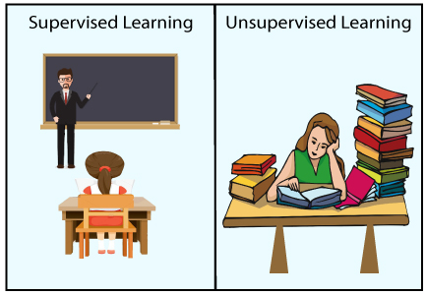
Advantages of Unsupervised learning:
Disadvantages of Unsupervised learning:
Unsupervised learning is used for more complex tasks as compared to supervised learning because, in unsupervised learning, we don't have labeled input data.
Unsupervised learning is preferable as it is easy to get unlabeled data in comparison to labeled data.
Unsupervised learning is intrinsically more difficult than supervised learning as it does not have corresponding output.
The result of the unsupervised learning algorithm might be less accurate as input data is not labeled, and algorithms do not know the exact output in advance.

Slide 15
Difference between Supervised and Unsupervised Learning
Supervised Learning | Unsupervised Learning
Supervised learning algorithms are trained using labeled data. | Unsupervised learning algorithms are trained using unlabeled data.
Supervised learning model takes direct feedback to check if it is predicting correct output or not. | Unsupervised learning model does not take any feedback.
Supervised learning model predicts the output. | Unsupervised learning model finds the hidden patterns in data.
In supervised learning, input data is provided to the model along with the output. | In unsupervised learning, only input data is provided to the model.
The goal of supervised learning is to train the model so that it can predict the output when it is given new data. | The goal of unsupervised learning is to find the hidden patterns and useful insights from the unknown dataset.
Supervised learning needs supervision to train the model. | Unsupervised learning does not need any supervision to train the model.
Supervised learning can be categorized in Classification and Regression problems. | Unsupervised Learning can be classified in Clustering and Associations problems.
Supervised learning can be used for those cases where we know the input as well as corresponding outputs. | Unsupervised learning can be used for those cases where we have only input data and no corresponding output data.
Supervised learning model produces an accurate result. | Unsupervised learning model may give less accurate result as compared to supervised learning.
Supervised learning is not close to true Artificial intelligence as in this, we first train the model for each data, and then only it can predict the correct output. | Unsupervised learning is more close to the true Artificial Intelligence as it learns similarly as a child learns daily routine things by his experiences.
It includes various algorithms such as Linear Regression, Logistic Regression, Support Vector Machine, Multi-class Classification, Decision tree, Bayesian Logic, etc. | It includes various algorithms such as Clustering, KNN, and Apriori algorithm.

Slide 16
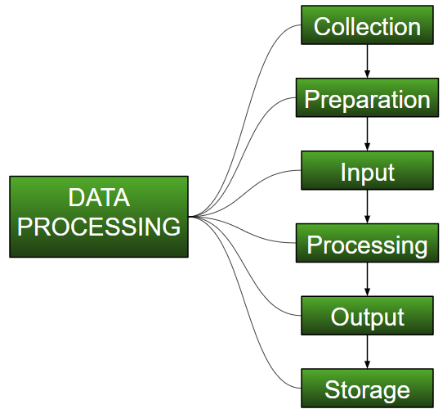
Understanding Data Processing
Data Processing is the task of converting data from a given form to a much more usable and desired form i.e. making it more meaningful and informative. Using Machine Learning algorithms, mathematical modeling, and statistical knowledge, this entire process can be automated. The output of this complete process can be in any desired form like graphs, videos, charts, tables, images, and many more, depending on the task we are performing and the requirements of the machine. This might seem to be simple but when it comes to massive organizations like Twitter, Facebook, Administrative bodies like Parliament, UNESCO, and health sector organizations, this entire process needs to be performed in a very structured manner. So, the steps to perform are as follows:

Slide 17
Collection :
The most crucial step when starting with ML is to have data of good quality and accuracy. Data can be collected from any authenticated source like data.gov.in, Kaggle or UCI Machine Learning Repository: Data Sets. For example, while preparing for a competitive exam, students study from the best study material that they can access so that they learn the best to obtain the best results. In the same way, high-quality and accurate data will make the learning process of the model easier and better and at the time of testing, the model would yield state-of-the-art results. A huge amount of capital, time and resources are consumed in collecting data. Organizations or researchers have to decide what kind of data they need to execute their tasks or research. Example: Working on the Facial Expression Recognizer, needs numerous images having a variety of human expressions. Good data ensures that the results of the model are valid and can be trusted upon.

Slide 18
Preparation :
The collected data can be in a raw form which can’t be directly fed to the machine. So, this is a process of collecting datasets from different sources, analyzing these datasets and then constructing a new dataset for further processing and exploration. This preparation can be performed either manually or from the automatic approach. Data can also be prepared in numeric forms also which would fasten the model’s learning. Example: An image can be converted to a matrix of N X N dimensions, the value of each cell will indicate the image pixel.

Slide 19
Input :
Now the prepared data can be in the form that may not be machine-readable, so to convert this data to the readable form, some conversion algorithms are needed. For this task to be executed, high computation and accuracy is needed. Example: Data can be collected through the sources like MNIST Digit data(images), Twitter comments, audio files, video clips.
Processing :
This is the stage where algorithms and ML techniques are required to perform the instructions provided over a large volume of data with accuracy and optimal computation.

Slide 20
Output :
In this stage, results are procured by the machine in a meaningful manner which can be inferred easily by the user. Output can be in the form of reports, graphs, videos, etc
Storage :
This is the final step in which the obtained output and the data model data and all the useful information are saved for future use.

Slide 21
Why do we need Data Preprocessing?
A real-world data generally contains noises, missing values, and maybe in an unusable format which cannot be directly used for machine learning models. Data preprocessing is required tasks for cleaning the data and making it suitable for a machine learning model which also increases the accuracy and efficiency of a machine learning model.
It involves below steps:
Getting the dataset
Importing libraries
Importing datasets
Finding Missing Data
Encoding Categorical Data
Splitting dataset into training and test set
Feature scaling

Slide 22
1) Get the Dataset

Slide 23
Get the Dataset
To create a machine learning model, the first thing we required is a dataset as a machine learning model completely works on data. The collected data for a particular problem in a proper format is known as the dataset.
Dataset may be of different formats for different purposes, such as, if we want to create a machine learning model for business purpose, then dataset will be different with the dataset required for a liver patient. So each dataset is different from another dataset. To use the dataset in our code, we usually put it into a CSV file. However, sometimes, we may also need to use an HTML or xlsx file.

Slide 24
What is a CSV File?
CSV stands for "Comma-Separated Values" files; it is a file format which allows us to save the tabular data, such as spreadsheets. It is useful for huge datasets and can use these datasets in programs.
Here we will use a demo dataset for data preprocessing, and for practice, it can be downloaded from here, "https://www.superdatascience.com/pages/machine-learning.
For real-world problems, we can download datasets online from various sources such as https://www.kaggle.com/uciml/datasets, https://archive.ics.uci.edu/ml/index.php etc.

Slide 25
2) Importing Libraries

Slide 26
Importing Libraries
In order to perform data preprocessing using Python, we need to import some predefined Python libraries. These libraries are used to perform some specific jobs. There are three specific libraries that we will use for data preprocessing, which are:
Numpy: Numpy Python library is used for including any type of mathematical operation in the code. It is the fundamental package for scientific calculation in Python. It also supports to add large, multidimensional arrays and matrices. So, in Python, we can import it as:
import numpy as nm
Here we have used nm, which is a short name for Numpy, and it will be used in the whole program.
Matplotlib: The second library is matplotlib, which is a Python 2D plotting library, and with this library, we need to import a sub-library pyplot. This library is used to plot any type of charts in Python for the code. It will be imported as below:
import matplotlib.pyplot as mpt
Here we have used mpt as a short name for this library.
Pandas: The last library is the Pandas library, which is one of the most famous Python libraries and used for importing and managing the datasets. It is an open-source data manipulation and analysis library.

Slide 27
3) Importing the Datasets

Slide 28
Importing the Datasets
Now we need to import the datasets which we have collected for our machine learning project. But before importing a dataset, we need to set the current directory as a working directory.

Slide 29
read_csv() function:
Now to import the dataset, we will use read_csv() function of pandas library, which is used to read a csv file and performs various operations on it. Using this function, we can read a csv file locally as well as through an URL.
We can use read_csv function as below:
data_set= pd.read_csv('Dataset.csv')
Here, data_set is a name of the variable to store our dataset, and inside the function, we have passed the name of our dataset. Once we execute the above line of code, it will successfully import the dataset in our code.

Slide 30
Extracting dependent and independent variables:
In machine learning, it is important to distinguish the matrix of features (independent variables) and dependent variables from dataset. In our dataset, there are three independent variables that are Country, Age, and Salary, and one is a dependent variable which is Purchased.

Slide 31
Extracting independent variable:
To extract an independent variable, we will use iloc[ ] method of Pandas library. It is used to extract the required rows and columns from the dataset.
x= data_set.iloc[:,:-1].values
In the above code, the first colon(:) is used to take all the rows, and the second colon(:) is for all the columns. Here we have used :-1, because we don't want to take the last column as it contains the dependent variable. So by doing this, we will get the matrix of features.
Extracting dependent variable:
To extract dependent variables, again, we will use Pandas .iloc[] method.
y= data_set.iloc[:,3].values
Here we have taken all the rows with the last column only. It will give the array of dependent variables.

Slide 32
4) Handling Missing data:

Slide 33
Handling Missing data:
The next step of data preprocessing is to handle missing data in the datasets. If our dataset contains some missing data, then it may create a huge problem for our machine learning model. Hence it is necessary to handle missing values present in the dataset.

Slide 34
Ways to handle missing data:
There are mainly two ways to handle missing data, which are:
By deleting the particular row: The first way is used to commonly deal with null values. In this way, we just delete the specific row or column which consists of null values. But this way is not so efficient and removing data may lead to loss of information which will not give the accurate output.
By calculating the mean: In this way, we will calculate the mean of that column or row which contains any missing value and will put it on the place of missing value. This strategy is useful for the features which have numeric data such as age, salary, year, etc. Here, we will use this approach.
To handle missing values, we will use Scikit-learn library in our code, which contains various libraries for building machine learning models. Here we will use Imputer class of sklearn.preprocessing library.

Slide 35
Ways to handle missing data:
Below is the code for it:
#handling missing data (Replacing missing data with the mean value)
from sklearn.preprocessing import Imputer or use from sklearn.impute import SimpleImputer if it throws error
imputer= Imputer(missing_values ='NaN', strategy='mean', axis = 0)
#Fitting imputer object to the independent variables x.
imputer= imputer.fit(x[:, 1:3])
#Replacing missing data with the calculated mean value
x[:, 1:3]= imputer.transform(x[:, 1:3])

Slide 36
5) Encoding Categorical data:

Slide 37
Encoding Categorical data:
Categorical data is data which has some categories such as, in our dataset; there are two categorical variable, Country, and Purchased.
Since machine learning model completely works on mathematics and numbers, but if our dataset would have a categorical variable, then it may create trouble while building the model. So it is necessary to encode these categorical variables into numbers.
For Country variable:
Firstly, we will convert the country variables into categorical data. So to do this, we will use LabelEncoder() class from preprocessing library.
#Catgorical data
#for Country Variable
from sklearn.preprocessing import LabelEncoder
4.lblenc = LabelEncoder()
5.df['Purchased'] = lblenc.fit_transform(df['Purchased'])

